Slide 1
EXPLAINABLE AI TECHNIQUES FOR IMAGE CLASSIFICATION

Slide 2
Outline
Problem Description
Introduction
DataSet
Proposed Methodology
CNN Model Architecture
SHAP
Grad-CAM
Conclusion
References

Slide 3
Problem Description
Deep learning excels in image classification but lacks interpretability.
Black-box nature raises concerns in critical domains.
This project focuses on Explainable AI (XAI) techniques for deep learning image classification.
Aims to enhance interpretability and provide insights into decision processes.
Essential for trust in critical applications like defense, healthcare, and autonomous vehicles.
Overview of various XAI techniques explored for image classification on CIFAR-10 dataset.

Slide 4
Introduction
Understanding the Need: XAI for Image Classification focuses on the importance of interpretability in deep learning models.
Objective: Aims to enhance the decision-making process in image classification models for better understanding, reliability, fairness, and compliance.
Impact: Develops acceptance, innovation, and responsible application of AI across diverse domains.
Key Goals: Improve understandability, reliability in deep learning models through XAI techniques.

Slide 5
Related Work
The influential work introduced Grad-CAM, a technique that generates class activation maps to visualize the regions of an image that are important for a specific class prediction. Grad-CAM uses the gradients of the predicted class score with respect to the feature maps of a CNN to produce heatmaps, allowing users to interpret the model's attention and decision-making process.[1]
The paper introduces a methodology to perform sanity checks on saliency maps, which are widely used for explaining the predictions of deep learning models. Saliency maps highlight the important regions of an input image that contribute to the model's decision.[3]
It explores the application of XAI techniques in interpreting CNN models for remote sensing image classification. It applies XAI methods such as Grad-CAM, LIME, and SHAP to provide insights into the CNN model's decision-making process and analyze the important features in remote sensing data. The study aims to enhance interpretability and validate the model's performance in the remote sensing domain.

Slide 6
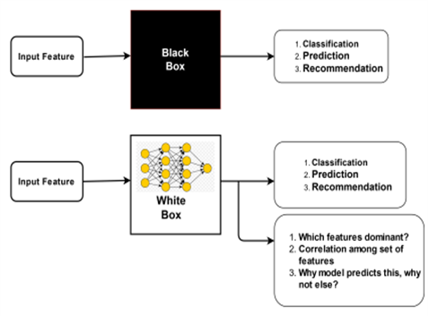
Black Box vs Interpretable Model

Slide 7
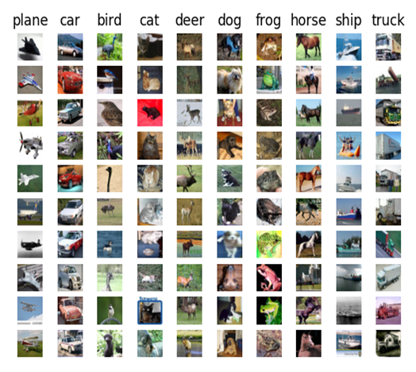
Dataset
Research centers on the CIFAR-10 dataset, a recognized benchmark in image classification.
Dataset Overview: CIFAR-10 consists of 60,000 32x32 color images across ten distinct classes.
Training and Testing Sets: Dataset is split into a training set (50,000 images) and a testing set (10,000 images).
Utilize deep learning techniques to classify images into categories like 'airplane,' 'automobile,' 'bird,' 'cat,' 'deer,' 'dog,' 'frog,' 'horse,' 'ship,' and 'truck.'

Slide 8
Proposed Methodology
1. Methodology:
Leverage multiple XAI techniques: SHAP, and Grad-CAM for enhanced interpretability in image classification.
Aim for a comprehensive understanding of the decision-making process in the proposed CNN-based architecture.
2. CNN Layers:
Key layers: Input, Convolution, Pooling, ReLU, Fully Connected.
Final layer translates filtered images into categories with labels.
3. XAI Techniques Implementation:
SHAP:
Provides model interpretability.
Analyzes feature contributions for the predictions.
Grad-CAM:
Utilizes gradients in the last convolutional layer.
Highlights important regions in the image for predicting specific concepts.
4. SHAP and Grad-CAM integrated for a better understanding of the deep learning model.
5.Spatial explanations and global interpretations provided by SHAP and Grad-CAM are discussed.

Slide 9
CNN Architecture
CNN framework with convolutional layers, pooling layers, dropout layers, and densely connected layers.
Designed with Keras, the model follows a sequential layering approach.
Focus on convolutional layers as feature extractors.
Aims to accomplish precise image classification using deep learning.

Slide 10
SHAP [SHapely Additive exPlanations]
SHAP (SHapley Additive exPlanations) is implemented for interpreting predictions of deep learning models, emphasizing the CIFAR-10 dataset.
Utilize a background dataset for SHAP computation to reveal feature importance.
SHAP values computed, offering graphical insights into feature/neuron influence.
Interpretation:
Positive attributions highlight features contributing to a favorable prediction.
Negative attributions spotlight features hindering the prediction.
Predicted class label correlates visual attributions with model's classification decision.

Slide 11
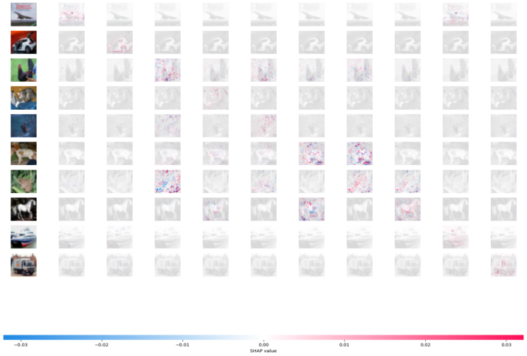


Slide 12
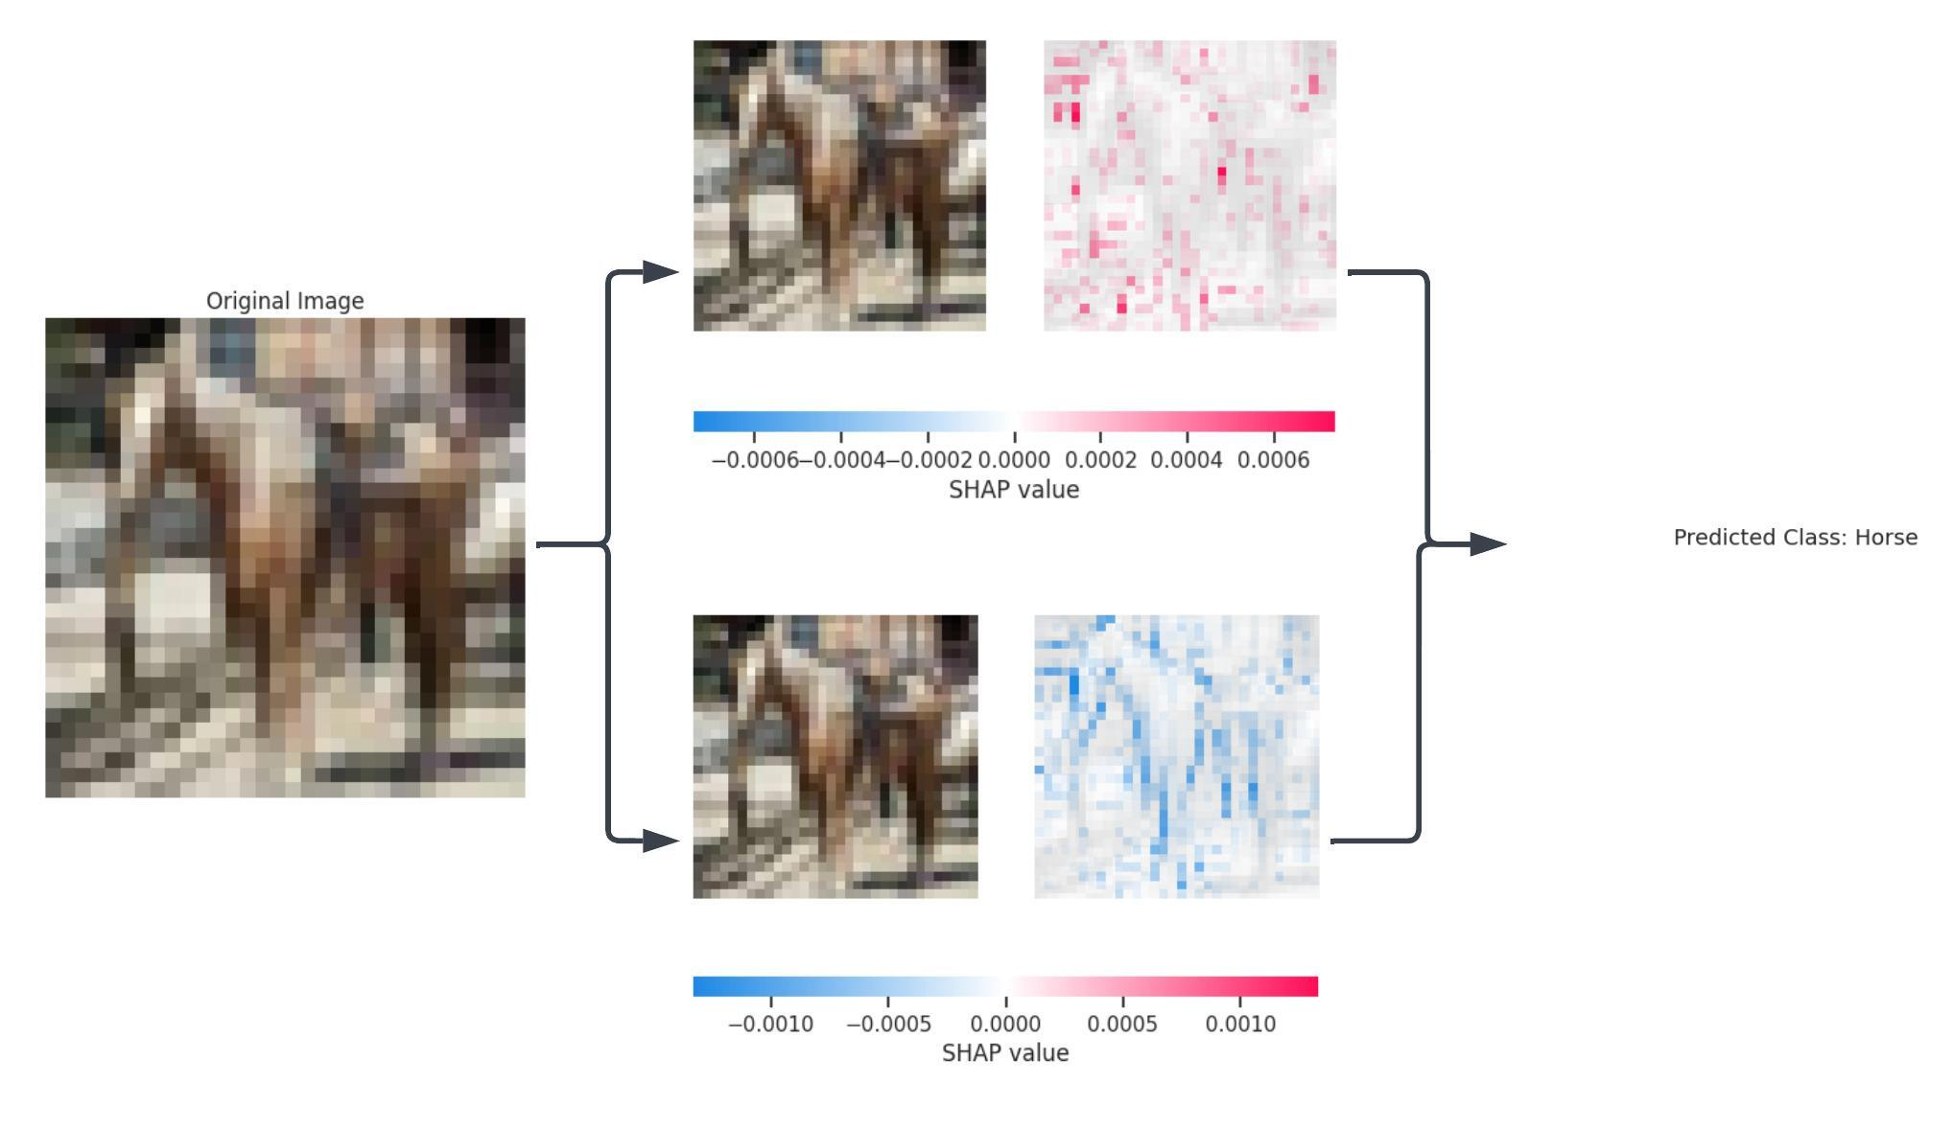
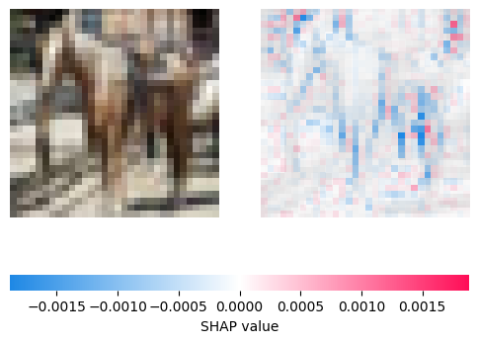

Slide 13
Grad-CAM [Gradient-weighted Class Activation Mapping]
Grad-CAM (Gradient-weighted Class Activation Mapping) incorporated for interpreting deep learning models on CIFAR-10.
Grad-CAM highlights regions influencing the model's classification decision.
Grad-CAM heatmaps dissected into positive and negative regions.
Positive regions which influence more to amplify predictions; negative regions also influences less.
Original image anchors subsequent visualizations.
Positive contributions heatmap (red color map) and negative contributions heatmap (blue color map) offer spectrum of influence.
Predicted class text correlates visual elements with the model's decision.

Slide 14
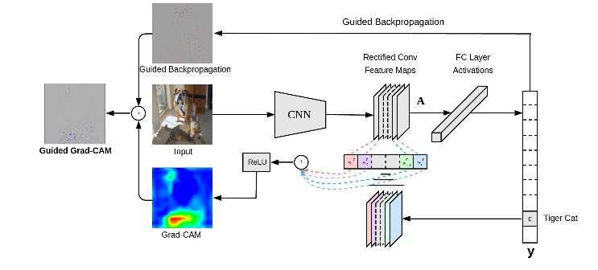
Grad-CAM Overview

Slide 15
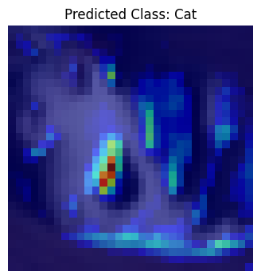
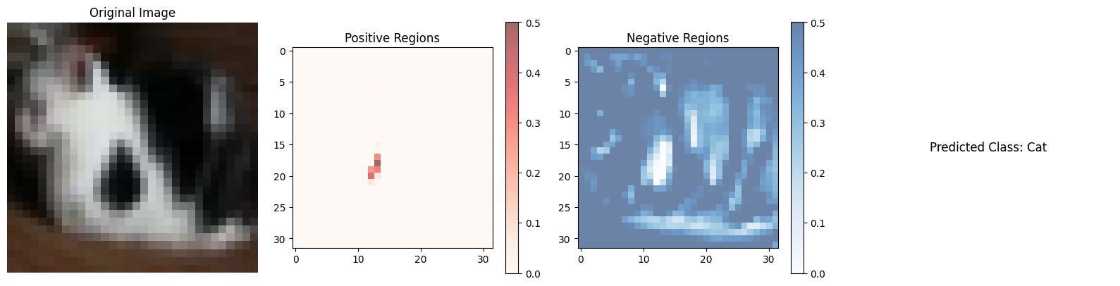

Slide 16
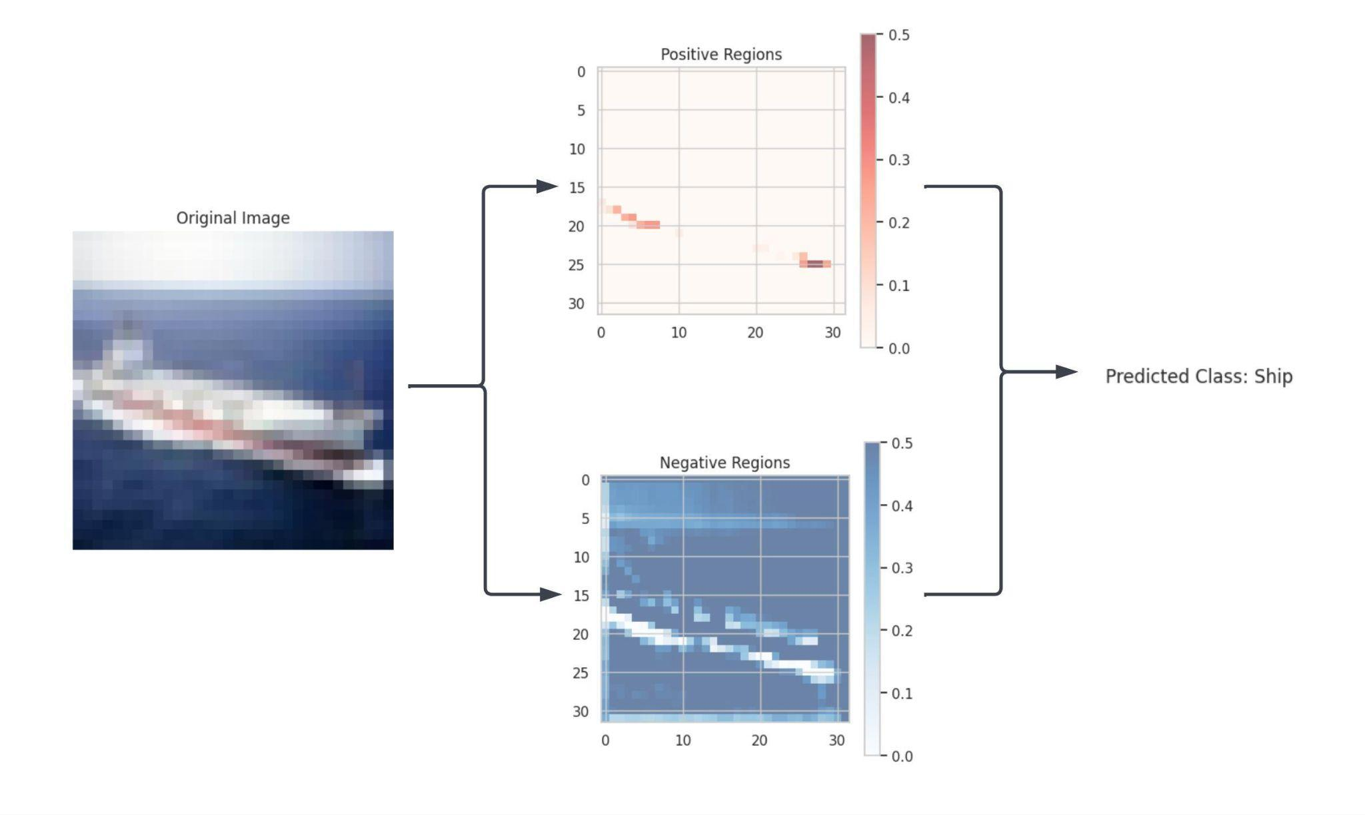

Slide 17
Conclusion
In summary, the research integrates SHAP and Grad-CAM for enhanced interpretability in deep learning models, focusing on the CIFAR-10 dataset. Positive and negative regions are dissected for a nuanced understanding and for improved interpretability. The approach enriches the interpretability, offering insights into model attention dynamics. Future exploration includes quantifying region importance and integrating visual insights into model development feedback loops.
Overall, the research contributes to transparency and responsible deployment of artificial intelligence, emphasizing a commitment to understanding the intricate decision-making processes in deep learning models.

Slide 18
References
“Grad-CAM: Visual Explanations from Deep Networks via Gradient-based Localization” by Ram prasaath R. Selvaraju, Michael Cogswell, Abhishek Das, Ramakrishna. CSCV 3 Dec 2019.
“Interpretability Beyond Feature Attribution: Quantitative Testing with Concept Activation Vectors (TCAV)” by Been Kim, Martin Wattenberg, Justin Gilmer, Carrie Cai, James Wexler, Fernanda Viegas, Rory Sayre. Stat.ML 7 Jun 2018.
“Explainable AI: Current Status and Future Directions”, Prashant Gohel, Priyanka Singh, Manoranjan Mohanty, cs.LG 12 Jul 2021.
“Explainable artificial intelligence (XAI) in deep learning-based medical image analysis”, Bas H.M. van der Velden, Hugo J.Kuijif, Kenneth G.A. Gilhuijs, Max A. Viergrever.
“Opportunities and challenges in explainable artificial intelligence (XAI): A survey”, A. Das and P. Rad, ArXiv 2020.
“Comparison between Grad-CAM and EigenCAM on YOLOv5 detection model”, Arief Nur Rahman, Dian Andriana, Carmadi Machbub, IEEE Nov 2022.

